Slide 1

Restaurant Recommendation Location-Based
Advanced topics in Machine
Dr. Chen Hajaj
Team:
Bar Nissim-Cohen
Tamir Hakimi

Slide 2

Agenda
1
2
3
4
Motivation
Methodology
Project motivation & Problem description
5
Algorithm & Technique in the project
Goals
Experiments
Project goals
6
Evaluating the techniques
Literature
Results
7
Methods & techniques learning
Project Implementation Results & Comparison
Data
Conclusion
8
Project conclusions
Data collecting & processing

Slide 3

1 Motivation
User Cold Start
None / very few number of consumed items.
Users that have provided no feedback.
Lack of information to model the user preferences.
It is hard to provide personalized recommendations for users.
The user’s data is empty, and there are no relations that can be inferred for this user.
One way where we can give new user recommendations would be through location proximity data.

Slide 4
Location-Based Recommendation System
2 Goals
Location
Restaurant Ratings
User’s Geographical Location
(longitude, latitude)
Recommend the Top 10 Nearby Restaurants
By providing an initial recommendation that is convenient for the user,
we can attract him to start using the platform and thereafter build on his initial preference to recommend other restaurants in more accurate methods

Slide 5

3 Literature
The naive solution to this problem
As the literature suggests:
First, give a random recommendation.
For every following recommendation:
take feedback, retrain, sort the predicted ratings, and return the highest projected recommendation.
This solution may work BUT we would like to create a more successful user experience in the first recommendation by relevancy of location & good restaurants

Slide 6

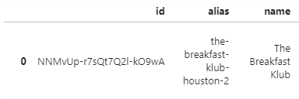
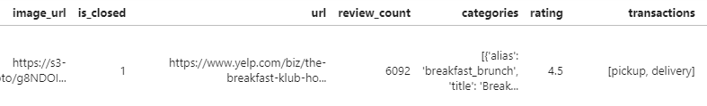
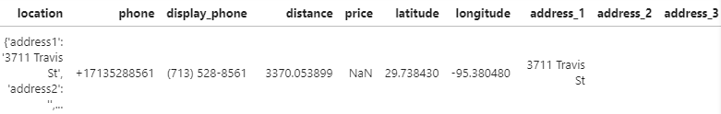

4 Data
Collect
Data
Yelp API –
Restaurants data: Texas
Data Preprocessing
Duplicate reduction
Split the “Coordinated” column into “latitude” & “longitude” columns.
created new columns as the addresses (restaurant branches).
Treat missing values (only in addresses- restaurant without 3+ branches)
Show open restaurants only.

Slide 7

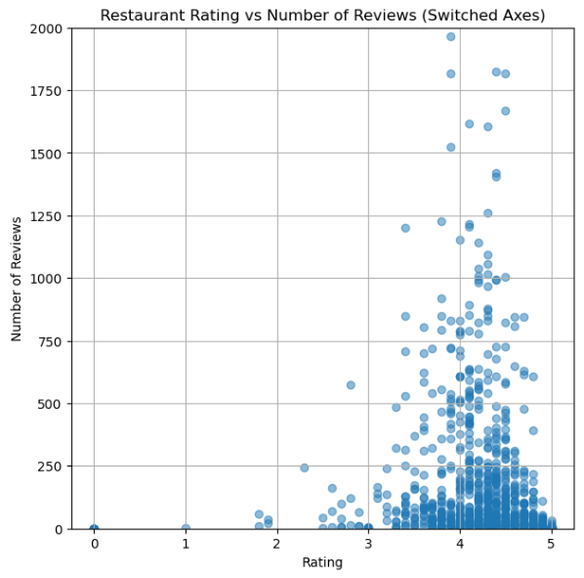
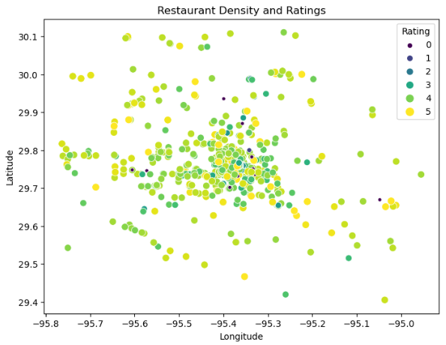
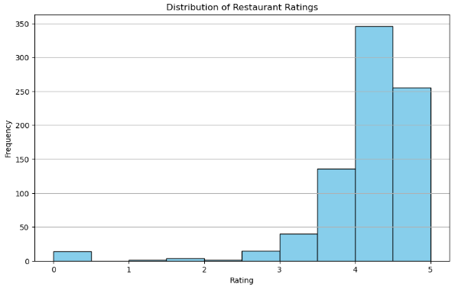
4 Data
Visualization
while customers are generally satisfied, they may reserve the highest rating for exceptional experiences.
customers are less likely to rate their experience unless it meets a baseline level of satisfaction.
A trend towards higher customer satisfaction.
establishments with greater review counts often deliver quality experiences consistently enough to maintain a high rating.
Most restaurants in data are at Houston in Texas (a significant urban center).
Quality may vary more significantly where restaurant options are abundant

Slide 8

5 Methodology
Clustering
K-Means
Cluster points based on proximity to centroid
Cluster Restaurants
Hierarchical Clustering
Silhouette Score
Recommendation Algritem
Organizing data
into classes
• high intra-class similarity
• low inter-class similarity
Cluster points based on proximity between clusters
Find the Optimal Clustering Method
(metric that measures how well each data point fits into its assigned cluster)
Based on location clustering
DBSCAN
Cluster points based on their density instead of proximity

Slide 9

6 Experiments
Recommendation Quality: Location
The quality of the clustering and recommendation of restaurants are close to the user's location.
Recommendation Quality: Rating
The effectiveness of the system in recommending high-rated restaurants within each cluster
Recommendation Quality: Response Time
Response time for generating recommendations, emphasizing high-performance

Slide 10
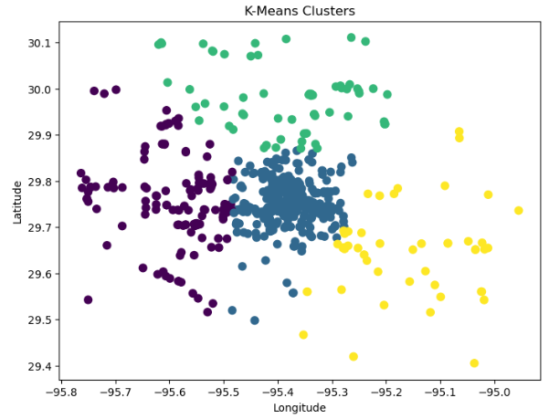
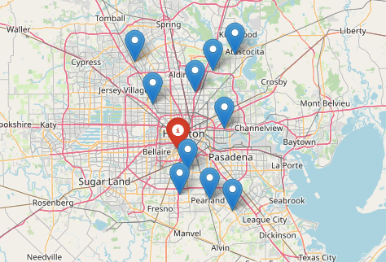

7 Results
Clustering
Hierarchical | DBSCAN | K-Means
0.485 | 0.734 | 0.537 | Location
Good Rate 3.5 – 4.3 | High Rate 4+ | 1 low 1 mid | Rating
0.039 | 0.0019 | 0.101 | Response Time
Quality
DBSCAN emerged as the top-performing algorithm.
K-means delivered strong results by capitalizing on the clear, separate clustering .
Hierarchical clustering demonstrated moderate effectiveness

Slide 11

8 Conclusion
Enhancing Recommendations with Geographical Insight
Geo-Targeted Precision: Employs user location to sustain recommendation quality, circumventing the need for extensive user history.
Streamlined Choices: Averts the risk of overwhelming new users with excessive options, ensuring a focused and quality introduction.
Strategic User Acquisition
Convenient Onboarding: Capitalizes on convenience, using immediate, location-aware recommendations to engage new users from the outset.
Building Trust: Proximity-based suggestions foster trust, enhancing the likelihood of feedback and continued interaction.

Slide 12
8 Conclusion
Driving Business Value
User Retention: Tailored, location-based recommendations have the potential to boost user retention by aligning with user needs from day one.
Revenue Growth: By delivering value immediately, the system sets the stage for heightened usage and, consequently, increased revenue potential.
Proposal for future projets:
Key constraints were a limited dataset size and no user data, impacting system tailoring and assessment. Future efforts should explore hybrid recommendation models (content-based filtering with collaborative techniques) to enhance personalization, especially for new users.

Slide 13




Thank You
Bar Nissim Cohen
&
Tamir Hakimi

